Slide 1
Group 9- Macro The AD_AS Model
Members：
Zheng Sutong
Li Yiwei
Li Xiuze
Zhao Yuxuan

Slide 2
Question 1:We have seen that short-run equilibrium output falls when the Fed raises the real interest rate. Suppose the relationship between short-run equilibrium output Y and the real interest rate r set by the Fed is given by Y = 1,000 - 1,000r.
(a) Suppose also that the Fed's reaction function is the one shown in the following table. For whole-number inflation rates between 0 and 4 percent, find the real interest rate set by the Fed and the resulting short-run equilibrium output. Graph the aggregate demand curve numerically.
Rate of inflation, π | Real interest rate, r
0.00 | 0.02
0.01 | 0.03
0.02 | 0.04
0.03 | 0.05
0.04 | 0.06

Slide 3
Note: By Taylor's Rule, Fed's policy reaction function is r = 0.01 + 0.5 × ((Y – Y*)/Y*) + 0.5 × π --> Fed reacts to both output gap and inflation rate. However, in the table, the reaction function reacts to inflation rate only.
Question 1.(a)
Rate of inflation, π | Real interest rate, r | Short-run equilibrium output, Y = 1,000 - 1,000r
0.00 | 0.02 | 1,000 - 1,000(0.02) = 980
0.01 | 0.03 | 1,000 - 1,000(0.03) = 970
0.02 | 0.04 | 1,000 - 1,000(0.04) = 960
0.03 | 0.05 | 1,000 - 1,000(0.05) = 950
0.04 | 0.06 | 1,000 - 1,000(0.06) = 940

Slide 4
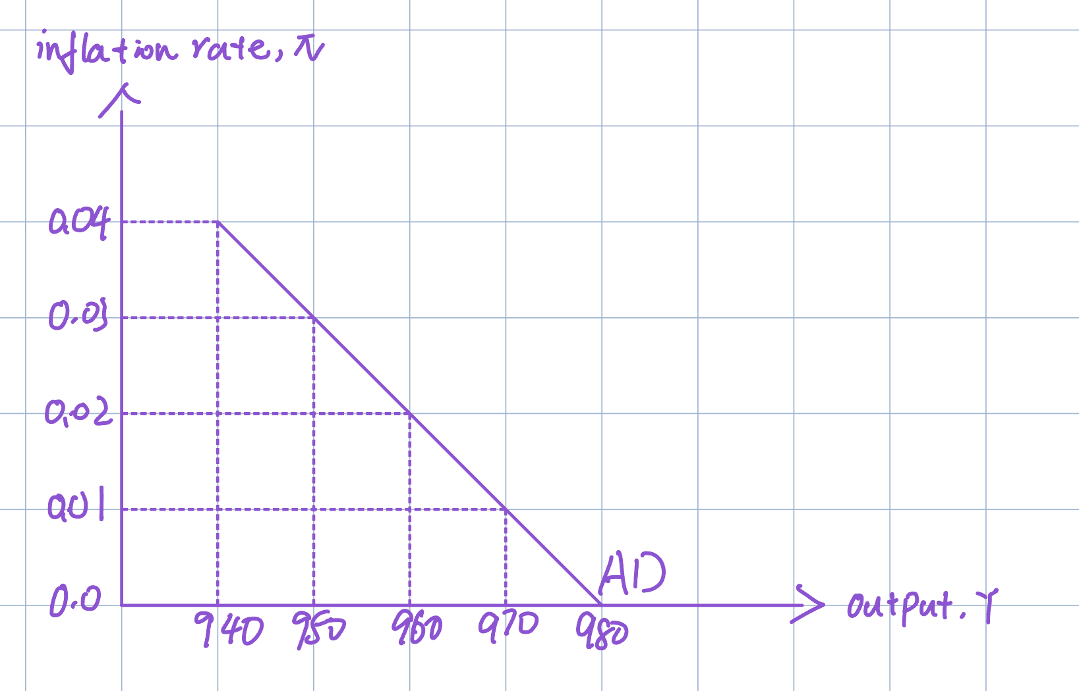
Rate of inflation, π | Short-run equilibrium output, Y
0.00 | 1,000 - 1,000(0.02) = 980
0.01 | 1,000 - 1,000(0.03) = 970
0.02 | 1,000 - 1,000(0.04) = 960
0.03 | 1,000 - 1,000(0.05) = 950
0.04 | 1,000 - 1,000(0.06) = 940

Slide 5
Question 1.(b): Suppose that potential output Y* = 960. From the policy reaction function in the table above, what can you infer about the Fed's objective for the inflation rate in the long term?
Rate of inflation, π | Real interest rate, r | Short-run equilibrium output, Y
0.00 | 0.02 | 1,000 - 1,000(0.02) = 980
0.01 | 0.03 | 1,000 - 1,000(0.03) = 970
0.02 | 0.04 | 1,000 - 1,000(0.04) = 960 = Y*
0.03 | 0.05 | 1,000 - 1,000(0.05) = 950
0.04 | 0.06 | 1,000 - 1,000(0.06) = 940
At the long-run equilibrium, actual output (Y) equals potential output (Y*).
Hence, at the long-run equilibrium, the real interest rate is 4%, the Fed's objective for inflation rate in the long term is 2%.

Slide 6
Question 2
g
This problem asks you to trace out the adjustment of inflation when the economy starts with an output gap. Suppose that the economy's aggregate demand curve is Y = 1,000 - 1,000π, where Y is short-run equilibrium output and π is the inflation rate, measured as a decimal. Potential output Y* equals 950, and the initial inflation rate is 10 percent (π= 0.10).
(a) Find output for this economy in short-run equilibrium and inflation in long-run equilibrium.
Answer: The economy's aggregate demand curve is given as Y=1000-1000π
At π is 0.10, the equilibrium output is
Y=1000-1000(π)
=1000-1000(0.1)
= 1000-100
= 900
The output in short-run equilibrium is
900
The equation shows the negative correlation between inflation and output. The calculated output is 900. When the rate of inflation is rising, then the output declines in the economy. Because the monetary value of the economy falls, that rises the price of goods and services but reduces demand and leads to reduce production and employment.

Slide 7
The output in the economy is given as follows:
Y*=1000-1000π
950=1000-1000π
π=0.05=5%
The long run is the period that all the price of all factors of production are variable in the market. The rate of inflation, in the long run, is 5%. The factors such as a fixed factor of production are those that do not change easily in short run. It takes a long time to purchase land or plant to increase production and also enterprise and capital is the fixed factor that cannot be changed in a short period.
The inflation rate in long-run equilibrium is 5%.

Slide 8
(b) Suppose that, each quarter, inflation adjusts according to the following rule: This quarter's inflation = Last quarter's inflation - 0.0004(Y* - Y) Starting from the initial value of 10 percent for inflation, find the value of inflation for each of the next five quarters. Remember, Y will continuously change as the current inflation rate change according to the given relationship Y = 1,000 - 1,000π. Does inflation come close to its long-run value?
Answer: The quarter inflation and output are calculated in the table that describes the five quarters' change in the output of the economy, the inflation rate changes, and the gap between potential and actual GDP levels.
The quarter inflation(QI) is calculated by the formula as follows:
QI=I_{n-1}-0.0004（Y∗-Y）
Note: the output gap is the previous quarter output gap

Slide 9
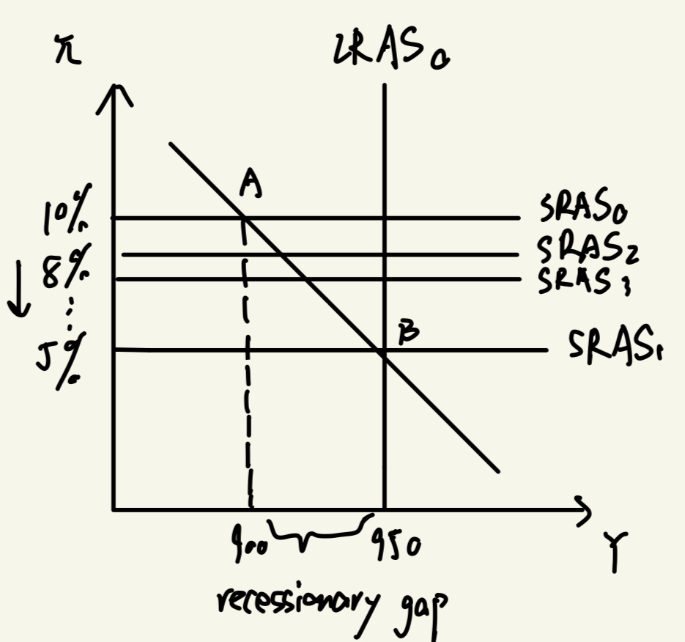
The table shows the actual output is increasing in the economy and coming closer to the actual GDP and the rate of inflation per quarter goes on declining and coming closer to the long-run equilibrium level. Note: The adjustment take time, in this eg, more than a year.
Y=1000-1000π | Y*-Y=950-Y | Inflation(π) | QI
900 | 950-900=50 | 0.10-0.0004(50)=0.08 | 8%
1000-1000(0.08)=920 | 950-920=30 | 0.08-0.0004(30)=0.068 | 6.8%
1000-1000(0.068)=932 | 950-932=18 | 0.068-0.0004(18)=0.0608 | 6.08%
1000-1000(0.0608)=939.2 | 950-939.2=10.8 | 0.0608-0.0004(10.8)=0.056 | 5.64%
1000-1000(0.056)=943.52 | 950-943.52=6.48 | 0.056-0.0004(6.48)=0.053 | 5.34%

Slide 10
Question 3
For each of the following, use an AD-AS diagram to show the short-run and long-run effects on output and inflation. Assume the economy starts in long-run equilibrium.
(a) An increase in consumer confidence that leads to higher consumption spending.
(b) An easing of monetary policy by the Fed (a downward shift in the policy reaction function).
(c) A sharp drop in oil prices.

Slide 11
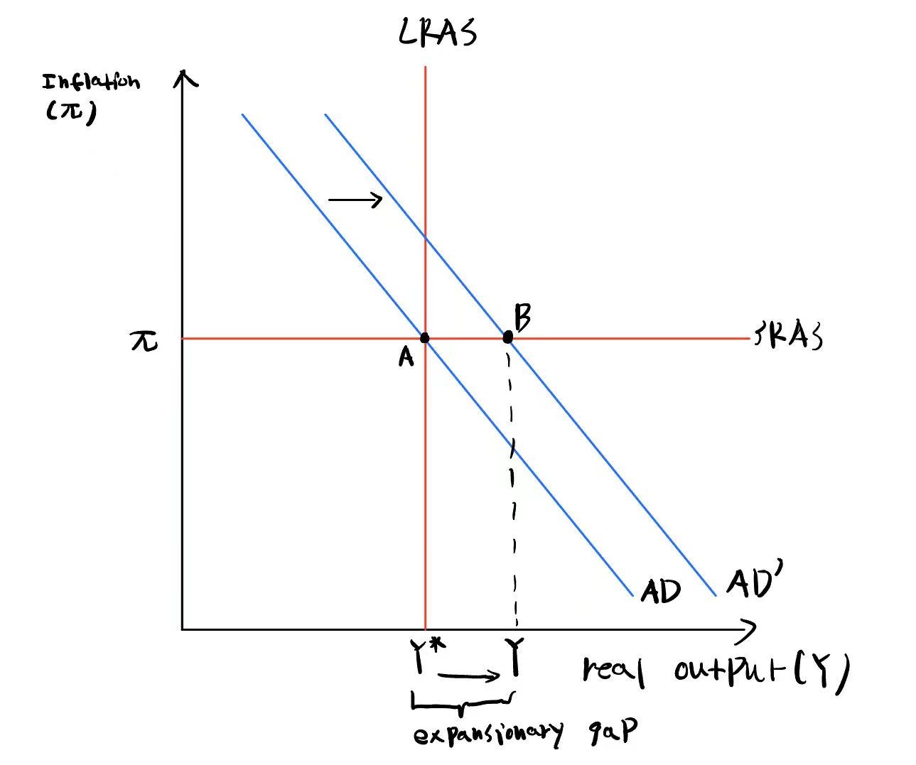
Question 3(a)
Short-run effect
An increase in consumer confidence that leads to higher consumption spending is an example of an exogenous increase in spending, this increase in spending is neither related to output(Y) nor real interest rate(r). As a result, this lead the AD curve shift to right, indicating an increase in aggregate demand in the short-run.
Short-run equilibrium occurs at the intersection of AD curve and SRAS line, it changes from point A to point B.
While short-run inflation is still determined by past expectations and pricing decisions, so inflation stays constant. An increase in AD leads real output to increase, creating an expansionary gap.

Slide 12
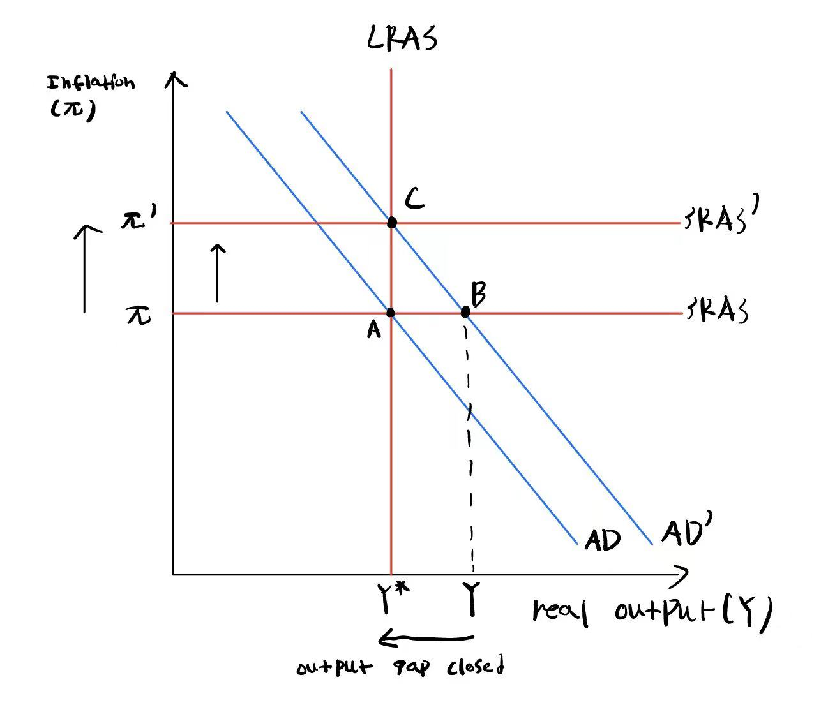
Question 3(a)
Long-run effect
In the long run, as firms are selling an amount more than their capacity to produce(expansionary gap), they would increase the rate at which they increase their prices.
Hence, inflation increases, the SRAS line moves upward.
As inflation rises, the federal reserve increases the real interest rate and output decreases, while increased inflation also raises uncertainty in the economy that decreases output(Y).
This adjustment continuous until long-run equilibrium is reached at point C, which is the intersection between AD, SRAS, and LRAS lines.
Hence, the long run effect is increased inflation while the level of real output decreased to potential output.

Slide 13
Question 3(b)
Short-run effect
A downward shift of the Fed’s reaction function lower real interest rate for all levels of inflation rate. A decrease in real interest rate for all levels of inflation reduces the marginal benefit to save, which encourage consumers and investors to spend more. This lead the AD curve shift to the right; aggregate demand increase in the short-run.
Short-run equilibrium occurs at the intersection of AD curve and SRAS line, it changes from point A to point B.
While short-run inflation is still determined by past expectations and pricing decisions, so inflation stays constant. An increase in AD leads real output to increase, creating an expansionary gap.

Slide 14
Question 3(b)
Long-run effect
In the long run, as firms are selling an amount more than their capacity to produce(expansionary gap), they would increase the rate at which they increase their prices.
Hence, inflation increases, the SRAS line moves upward.
As inflation rises, the federal reserve increases the real interest rate and output decreases, while increased inflation also raises uncertainty in the economy that decreases output(Y).
This adjustment continuous until long-run equilibrium is reached at point C, which is the intersection between AD, SRAS, and LRAS lines.
Hence, the long-run effect is increased inflation while the level of real output decreased to potential output.

Slide 15
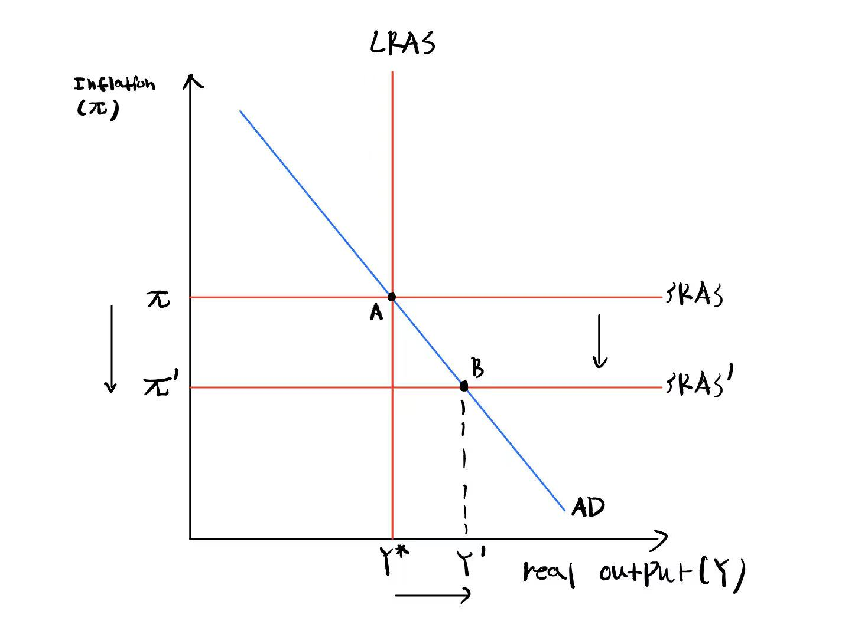
Question 3(c)
Short-run effect
In the short-run, sharp falling oil prices is an example of favorable inflation shock – an inflation shock that reduces inflation.
More specifically, sharp decreases in oil prices can transfer to lower prices of gasoline, heating oil, and goods and services that were dependent on oil, leading inflation to decrease.
As inflation decreases, SRAS line shifts downward.
A new equilibrium is established at point B, as a result, inflation decreases and real output increases, created an expansionary gap.

Slide 16
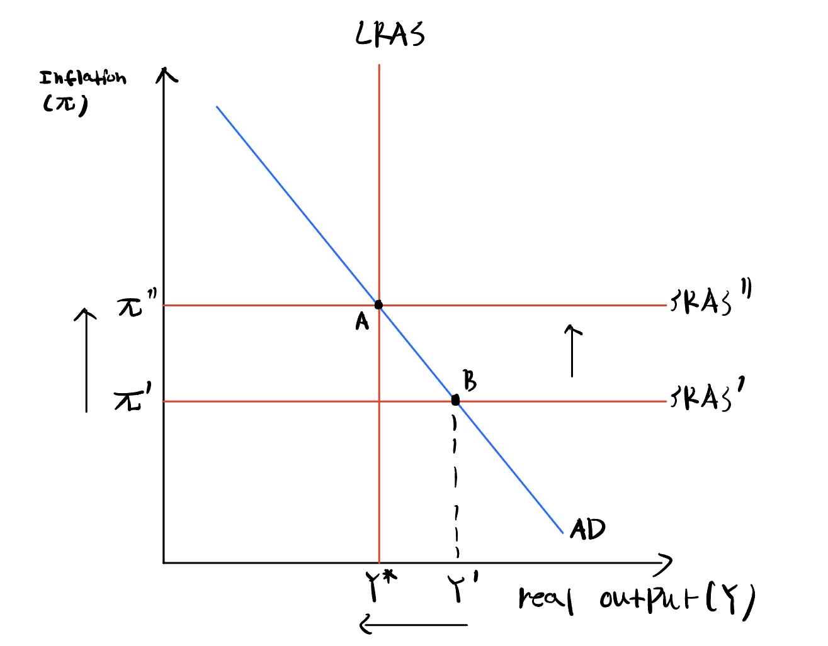
Question 3(c)
Long-run effect
In the long run, as firms are selling an amount more than their capacity to produce(expansionary gap), they would increase the rate at which they increase their prices.
Hence, inflation increases, the SRAS line moves upward.
As inflation rises, the federal reserve increases the real interest rate and output decreases, while increased inflation also raises uncertainty in the economy that decreases output(Y).
This adjustment continuous until long-run equilibrium is reached at point A, which is the intersection between AD, SRAS, and LRAS lines.
Hence, the long run effect is increased inflation while the level of real output decreased to potential output.

Slide 17
Question 4
Suppose that a permanent increase in oil prices both creates an inflationary shock and reduces potential output. Use an AD-AS diagram to show the effects of the oil price increase on output and inflation in the short run and the long run, assuming that there is no policy response. What happens if the Fed responds to the oil price increase by tightening monetary policy?

Slide 18
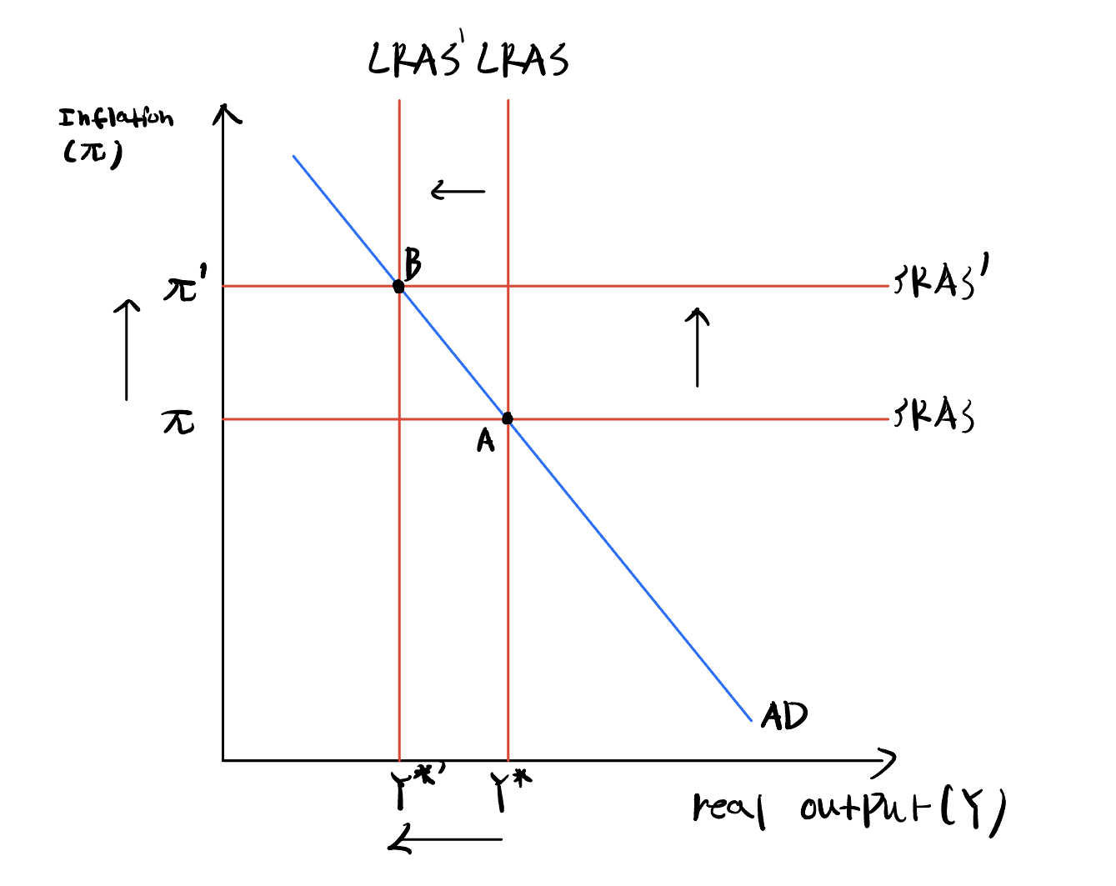
Question 4(short-run and long-run effect)
Permanent oil prices is an example of shock to potential output and inflation shock, this happens at the same time.
More specifically, as oil prices increases, firms can afford less machineries, so firms are able to operate on less capitals.
This lead to the quantity of factors of production to decrease, the maximum capacity of firms to supply good decrease, so potential output decreased with LRAS.
As the current output(Y=Y*) is more than new potential output(Y*'), there is presence of expansionary gap.
Firms are selling an amount more than their capacity to produce(expansionary gap), they would increase the rate at which they increase their prices. Inflation increases, SRAS increases to point B, the long-run equilibrium. Real output decreases to new potential output.

Slide 19
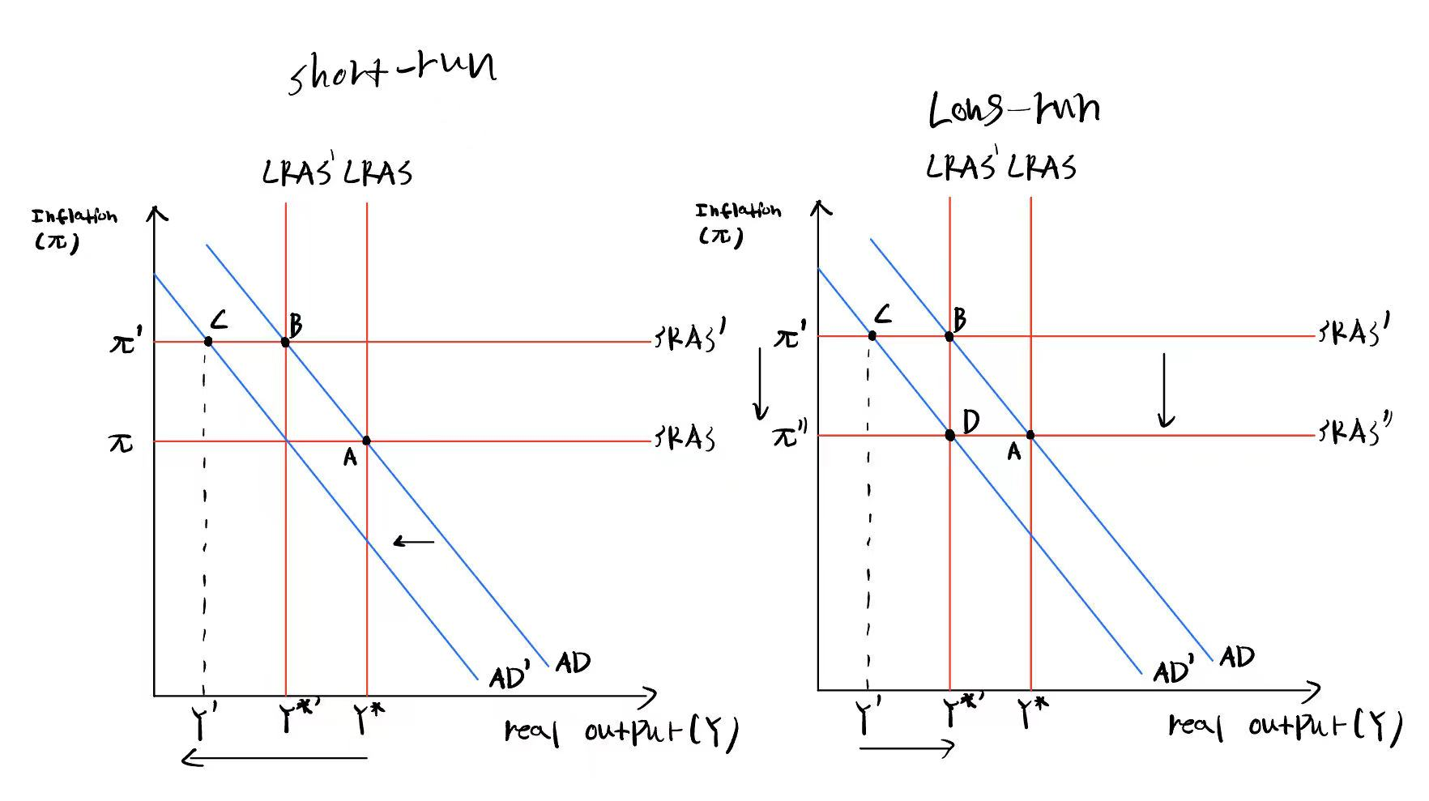
Question 4(Anti-inflationary monetary policy)
The problem raised by increase oil prices is high rate of inflation
If the Fed responds to the oil price increase by tightening monetary policy, this means that there is an upward shift of the Fed's reaction – a higher real interest rates for all levels of inflation rate.
In the short-run, as real interest rate increase, the marginal benefit to save money increase, so consumers and investors would choose to spend less and save more. Hence, AD curve would decrease shift to the left, causing real output to decrease significantly (recessionary gap). New short-run equilibrium is established at point C.
In the long run, as firms are selling an amount less than their capacity to produce(recessionary gap), they would decrease the rate at which they increase their prices. Hence, inflation decreases, the SRAS line moves downward, real output increases to potential output. New long-run equilibrium is established at point D.

Slide 20
Question 5
An economy is initially in recession. Using the AD-AS diagram, show the process of adjustment:
(a) If the Fed responds by easing monetary policy (moving its reaction function down).
(b) If the Fed takes no action.
What are the costs and benefits of each approach, in terms of output loss and inflation?

Slide 21
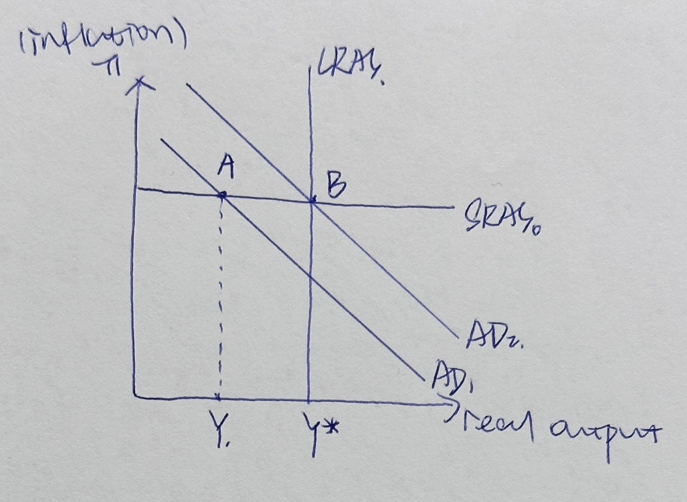
(a) If the Fed responds by easing monetary policy (moving its reaction function down).
In the recession,the economy always faces high unemployment as well as the low output. Therefore,the recessonary gap exists,the AD1 curve intersects shoort-run AS at A,at which the real output is Y.
Because the Fed responds by easing monetary policy,the increase in real interest rate and the inflation are relatively slower.And thus the decrease in investment and consumption are slower,finally the decrease in output will be slower,the AD1 curve shifts rightwards to AD2.
AS curve remains constant,as AD shifts,the intersection point moves from A to B,and the actual output increases from Y to Y*,the recessionary gap will be eliminated in the end.

Slide 22
(a) If the Fed responds by easing monetary policy (moving its reaction function down).
Benefit:
Output gap narrows at faster rate after the Fed easing monetary policy,and thus the recessionary gap eliminates in the end.The unemplyment rate will decrease and the aggregate demand will be promoted.
Costs:
The costs of easing monetary policy is inflation. Assuming the Fed did nothing, the SRAS
will fall to LRAS, which will lead to a decrease in inflation rate, with AD curve staying
constant

Slide 23
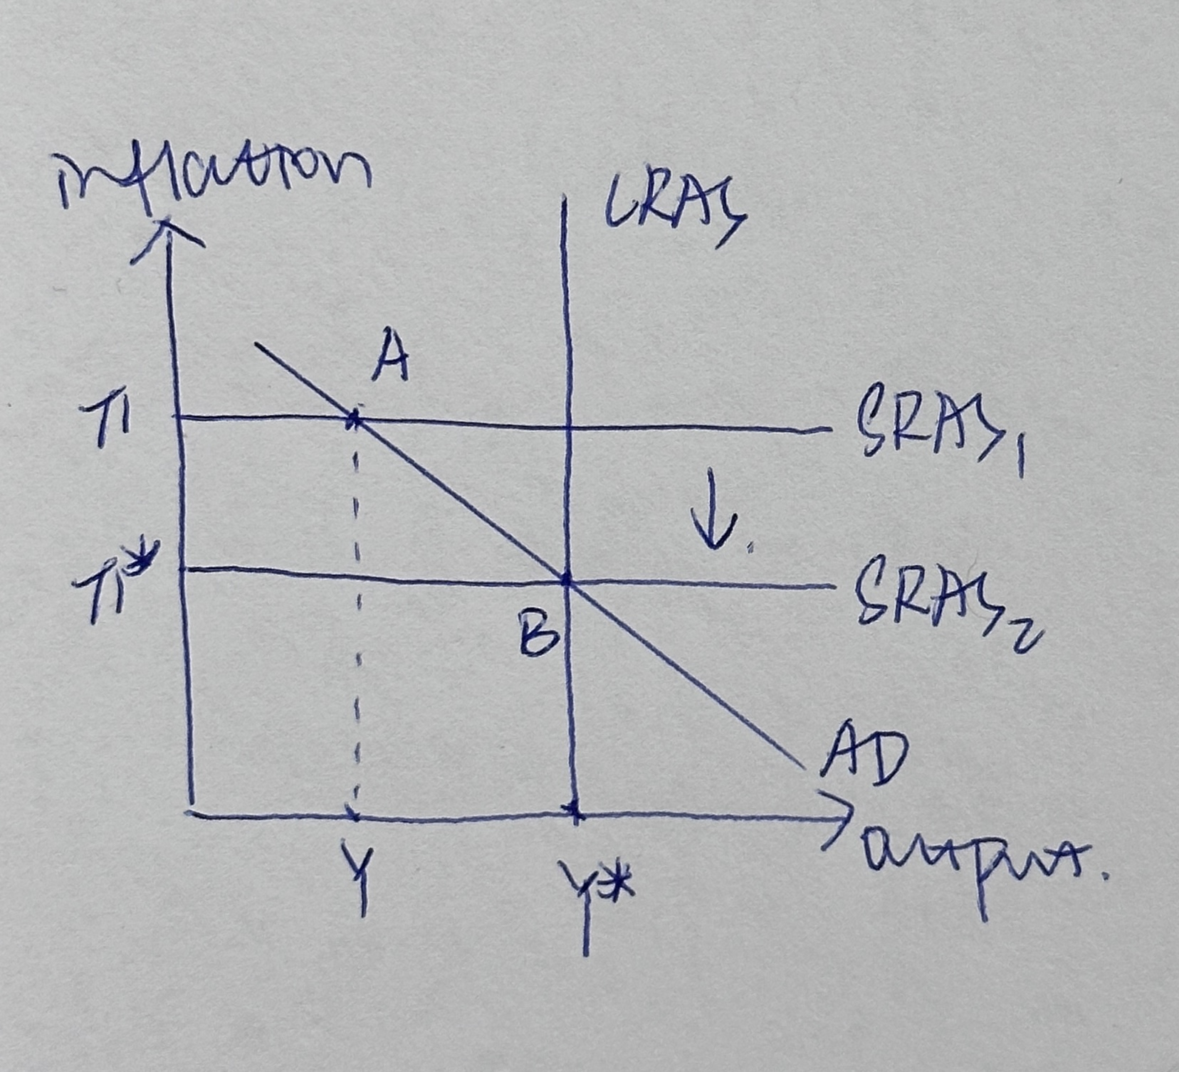
(b) If the Fed takes no action.
Because the economy is in a recession,the output gap exists.The AD curve intersects the SRAS at the point A in which the output is Y.
When the Fed takes no action,the aggregate demand not changes.Because the market is not in the long-run equilibrium currently,the market will slowly correct itself towards long-run equilibrium,and this will result in the downward shift of SRAS.The inflation decreases.
The intersection point moves from A to B,which the output increases from Y to Y*,the recession is corrected.

Slide 24
(b) If the Fed takes no action.
Benefit:
The inflation rate decreases and the output gap eliminates in the end.
No opportunity costs for the government to correct the market.
Costs:
The speed for SRAS1 moves to SRAS2 is hard to predict which depend on lots of variables.

Slide 25
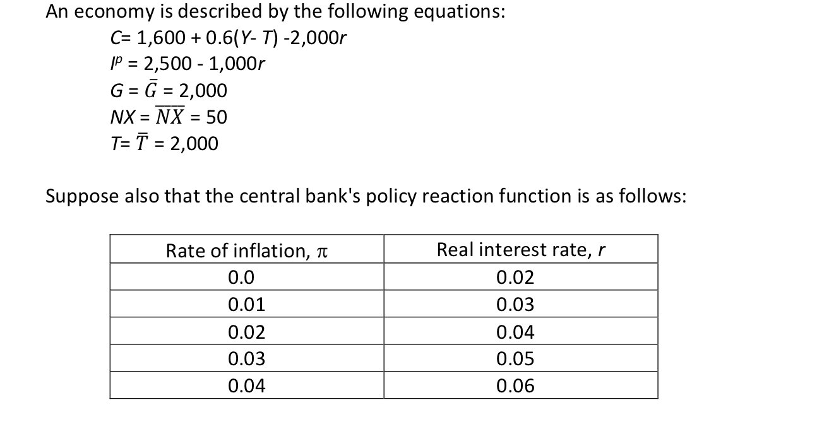
Question 6

Slide 26
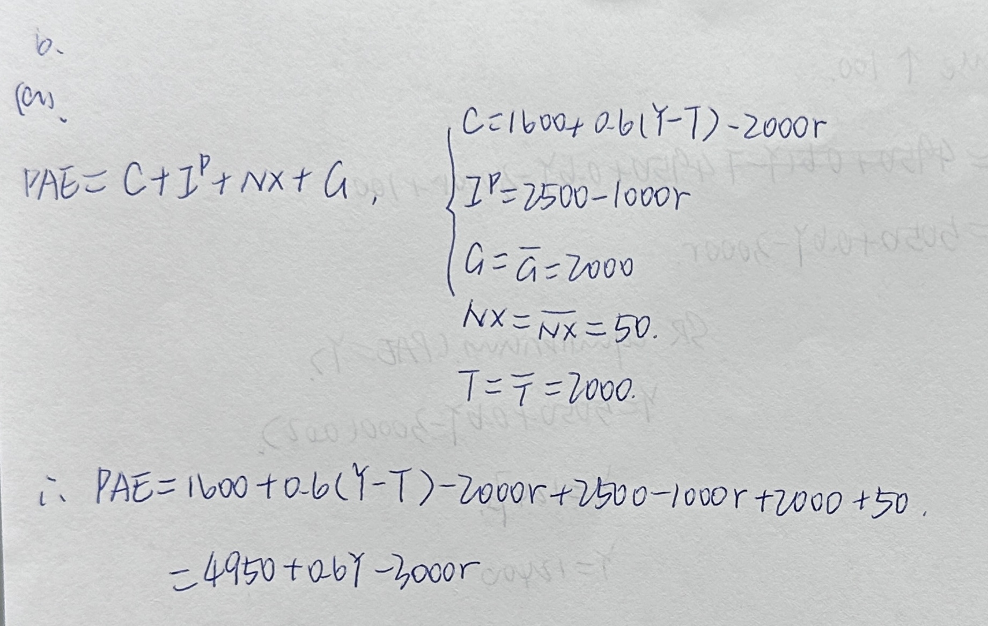
(a)Find an equation relating planned spending to output and the real interest rate

Slide 27
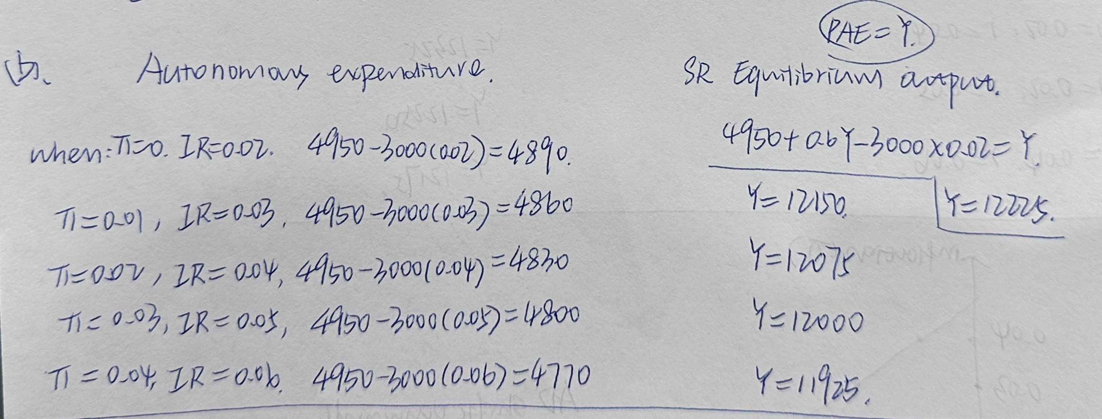
(b) Complete the following table. Graph the aggregate demand curve of the economy

Slide 28
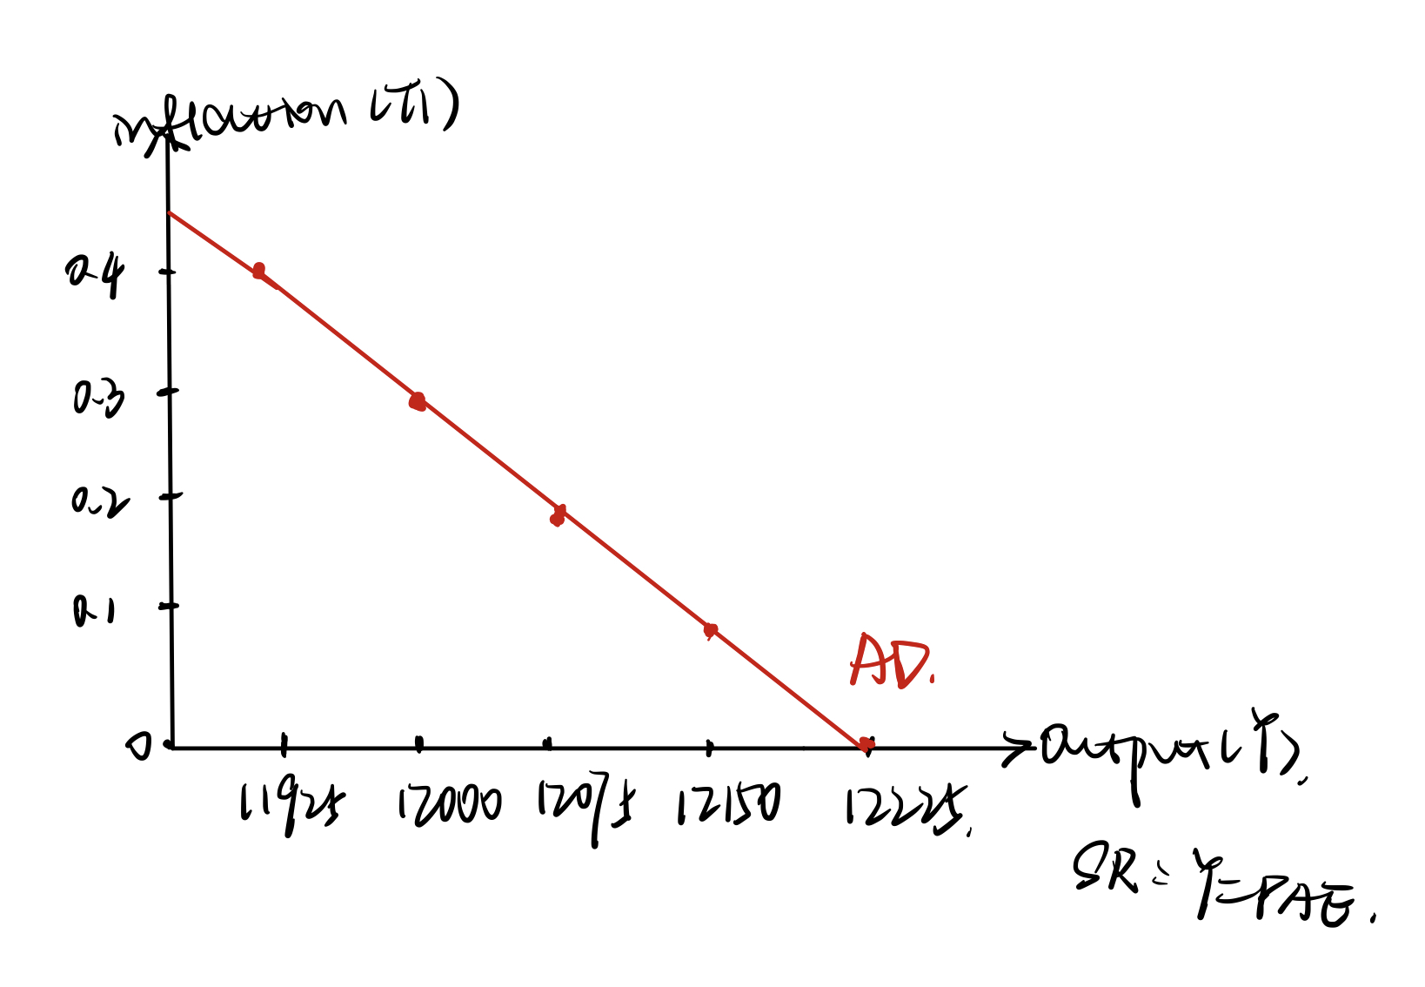
(b) Complete the following table. Graph the aggregate demand curve of the economy

Slide 29
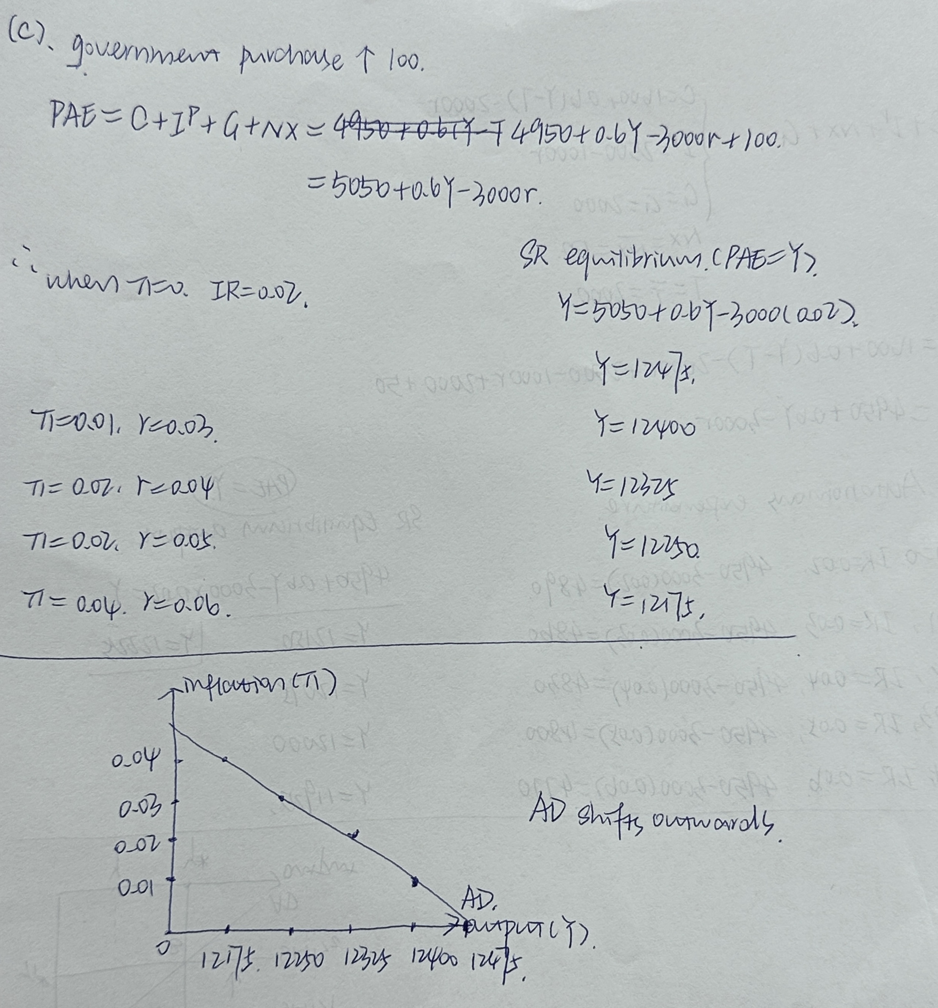
(c) Repeat parts (a) and (b), assuming that government purchases have increased to 2,100. How does an increase in government purchases affect the AD curve

Slide 30
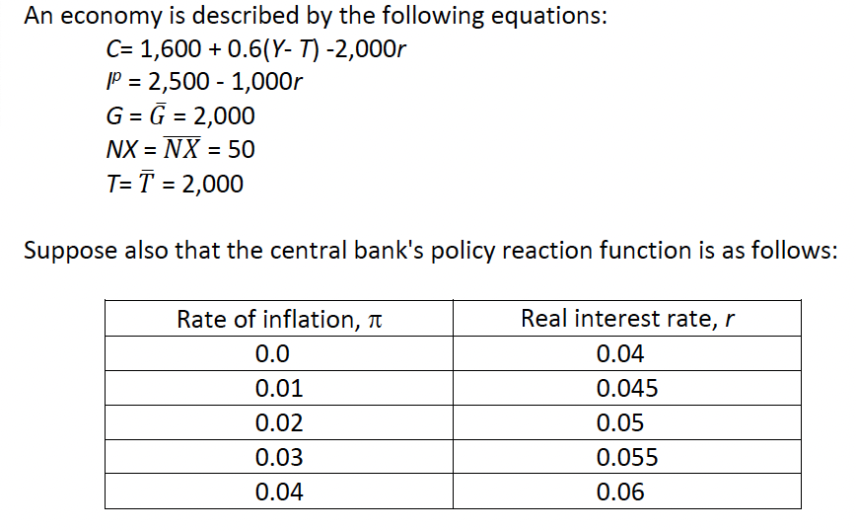
Question 7

Slide 31
(a) Complete the following table. Graph the aggregate demand curve of the economy.
Inflation Rate | Real Interest Rate | Autonomous Expenditure = 4950 – 3000r | SR Equilibrium Output Y = PAE
0.0 | 0.04 | 4950 – 3000(0.04) = 4830 | ((4950 – 3000 × 0.04)/0.4) = 12075
0.01 | 0.045 | 4950 – 3000(0.045) = 4815 | ((4950 – 3000 × 0.045)/0.4) = 12037.5
0.02 | 0.05 | 4950 – 3000(0.05) = 4800 | ((4950 – 3000 × 0.05)/0.4) = 12000
0.03 | 0.055 | 4950 – 3000(0.055) = 4785 | ((4950 – 3000 × 0.055)/0.4) = 11962.5
0.04 | 0.06 | 4950 – 3000(0.06) = 4770 | ((4950 – 3000 × 0.06)/0.4) = 11925
PAE = C + I + G + NX
PAE = 1600 + 0.6(Y – 2000) - 2000r + 2500 – 1000r + 2000 + 50 = 4950 + 0.6Y - 3000r
PAE = Y = 4950 + 0.6Y - 3000r
Y = ((4950 – 3000r)/0.4)

Slide 32
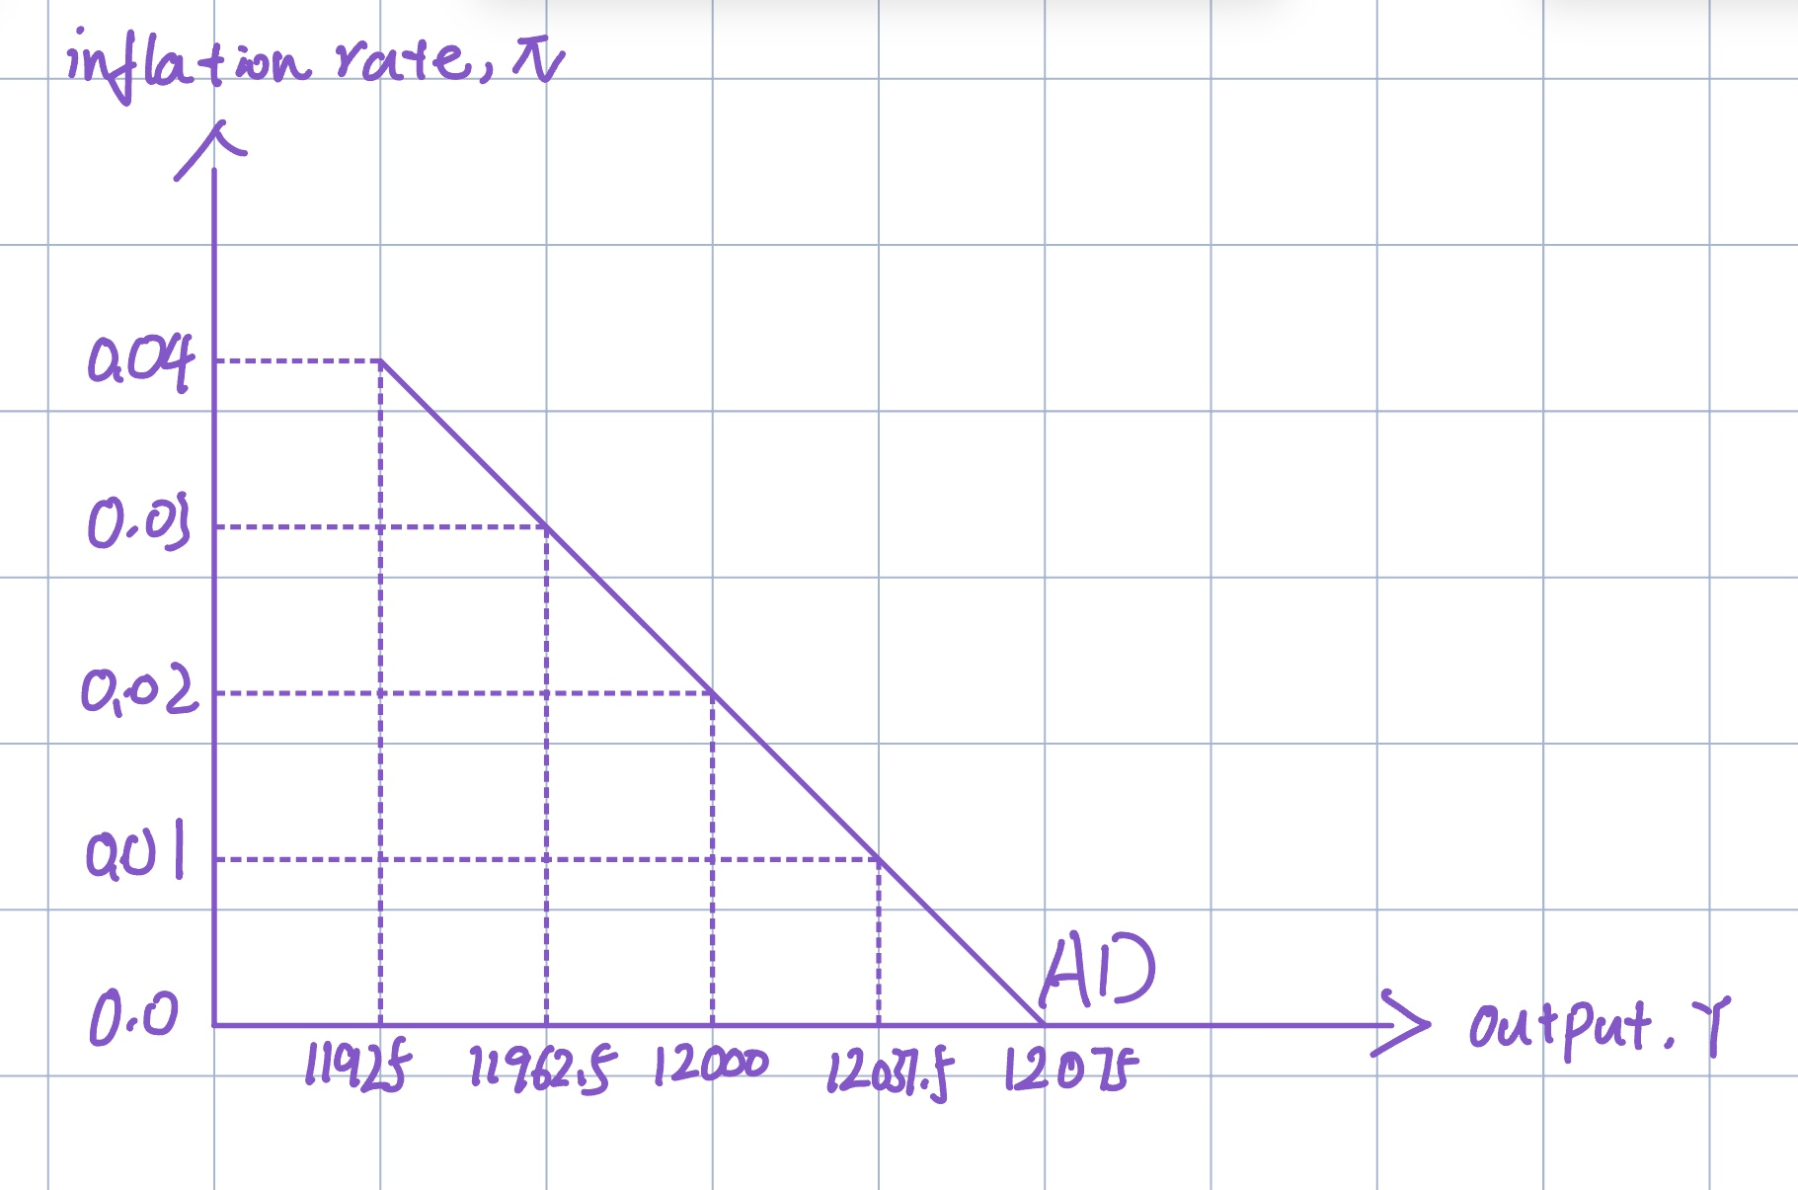
Question 7.(a) The AD curve
Inflation Rate | SR Equilibrium Output Y = PAE
0.0 | ((4950 – 3000 × 0.04)/0.4) = 12075
0.01 | ((4950 – 3000 × 0.045)/0.4) = 12037.5
0.02 | ((4950 – 3000 × 0.05)/0.4) = 12000
0.03 | ((4950 – 3000 × 0.055)/0.4) = 11962.5
0.04 | ((4950 – 3000 × 0.06)/0.4) = 11925

Slide 33
7. (b) Suppose that the central bank decides to lower the real interest rate by 0.5 percentage point at each value of inflation. Repeat part (a). How does this change in monetary policy affect the aggregate demand curve?
Inflation Rate | Real Interest Rate | Autonomous Expenditure = 4950 – 3000r | SR Equilibrium Output Y = PAE
0.0 | 0.035 | 4950 – 3000(0.035) = 4845 | ((4950 – 3000 × 0.035)/0.4) = 12112.5
0.01 | 0.04 | 4950 – 3000(0.04) = 4830 | ((4950 – 3000 × 0.04)/0.4) = 12075
0.02 | 0.045 | 4950 – 3000(0.045) = 4815 | ((4950 – 3000 × 0.045)/0.4) = 12037.5
0.03 | 0.05 | 4950 – 3000(0.05) = 4800 | ((4950 – 3000 × 0.05)/0.4) = 12000
0.04 | 0.055 | 4950 – 3000(0.055) = 4785 | ((4950 – 3000 × 0.055)/0.4) = 11962.5

Slide 34
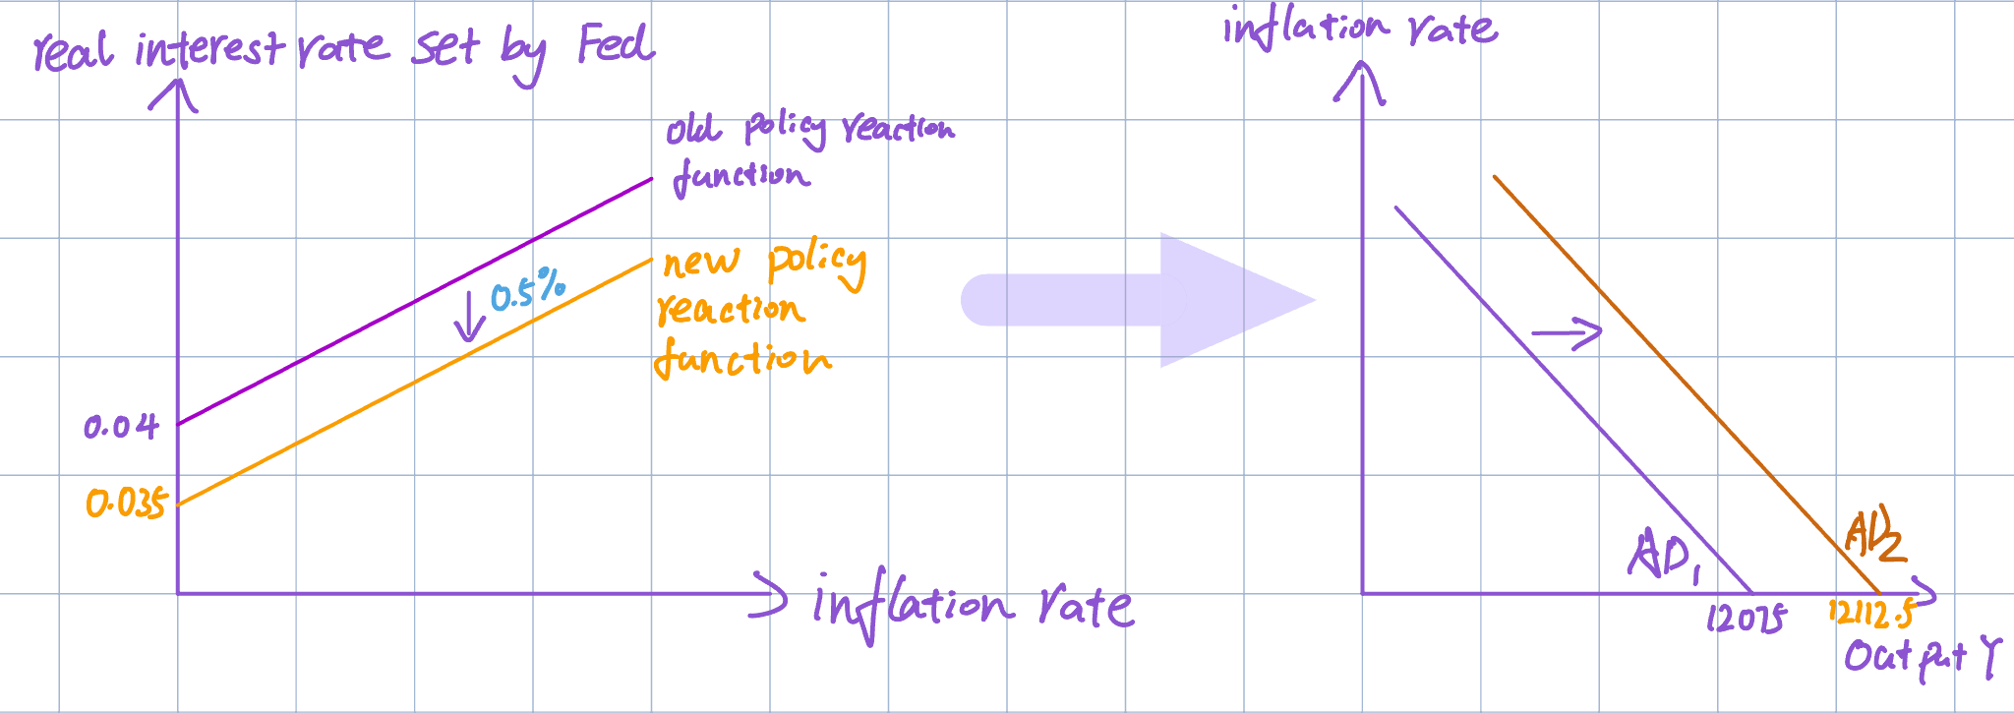
7.(b) How does this change in monetary policy affect the aggregate demand curve?
After the fall in interest rate, the policy reaction function curve shifts downward by 0.5 percentage point.
The AD curve shifts to the right. For every level of inflation, the output increases by 37.5 units.

